Slide 1

Configuration of MongoDB

Slide 2


Requirements
On Windows MongoDB requires Windows Server 2008 R2, Windows Vista, or later.
The mongodb.msi installer
Sufficient RAM

Slide 3
Download MongoDB for Windows
Download the latest production release of MongoDB from the MongoDB downloads page. (https://www.mongodb.org/downloads?_ga=1.201830673.1610439161.1437582121 )
Ensure you download the correct version of MongoDB for your Windows system.
The 64-bit versions of MongoDB do not work with 32-bit Windows.

Slide 4

Installation
Double click the .msi file.
Install the Mongodb
Database

Slide 5
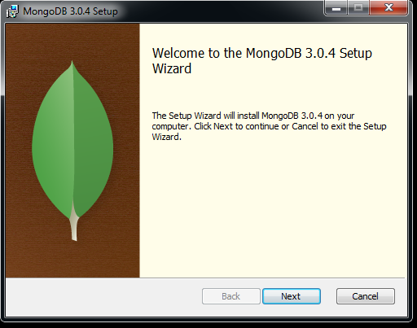
Installation
Click next
Database

Slide 6
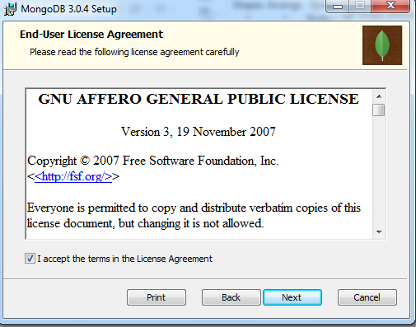
Installation
Agree the terms and condition of mongdb
Click next
Database

Slide 7
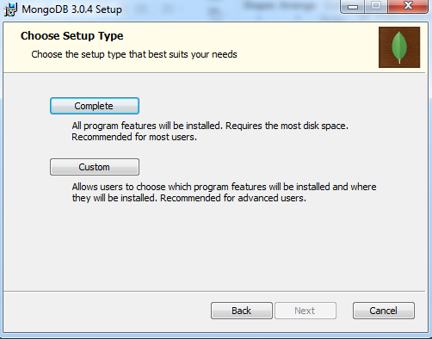
Installation
Click complete
Database

Slide 8
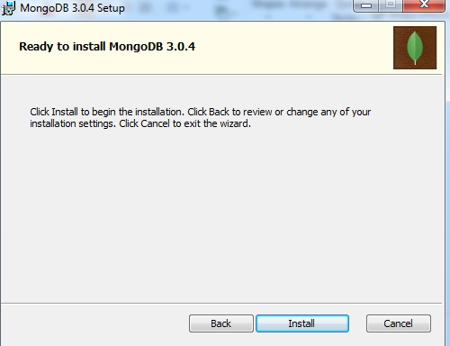
Installation
Click install to install Mongdb
Database

Slide 9
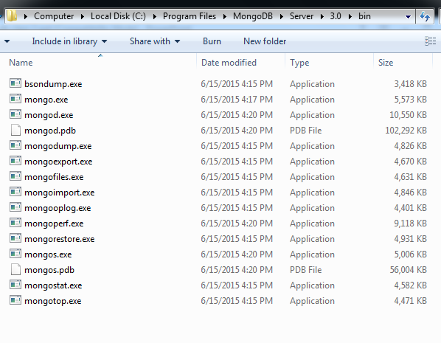
Check the installation
There should be folder all binaries in below path
“C:\Program Files\MongoDB\Server\3.0\bin”
Database

Slide 10
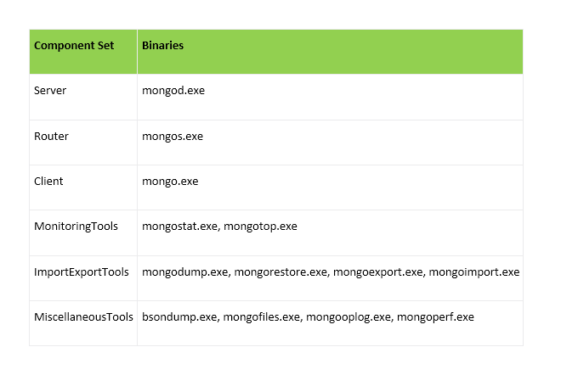
Components

Slide 11
Set up the MongoDB environment
MongoDB requires a data directory to store all data.
MongoDB’s default data directory path is \data\db.
Create this folder in any path you need

Slide 12
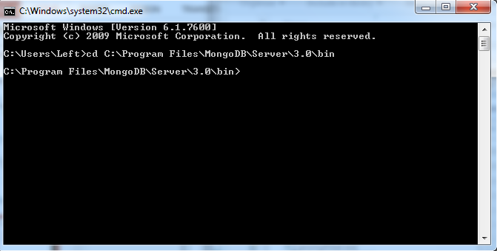
Start MongoDB Server
open command prompt
Execute below command to enter into Mongodb bin folder
Cd “C:\Program Files\MongoDB\Server\3.0\bin”
Notes:
Flexible schema
Javascript

Slide 13
Connect to MongoDB Server
connect to MongoDB through the mongod.exe shell
Type Mongod.exe – dbpath “ path of data file which you created” and press enter
Database

Slide 14
Connect to MongoDB Client
Open another command prompt
connect to MongoDB through the mongo.exe shell
Type Mongo.exe and press enter

Slide 15
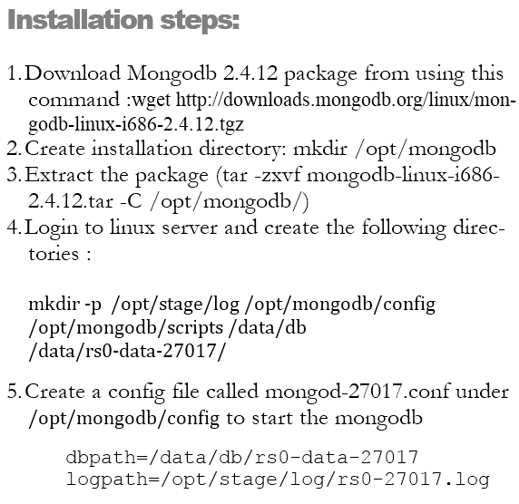
Mongodb in Linux

Slide 16
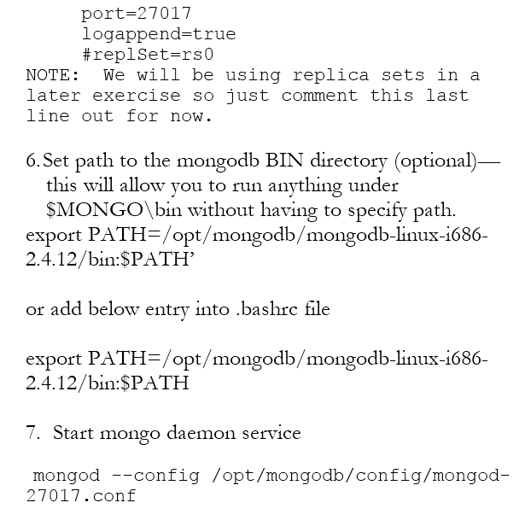
Mongodb in Linux

Slide 17
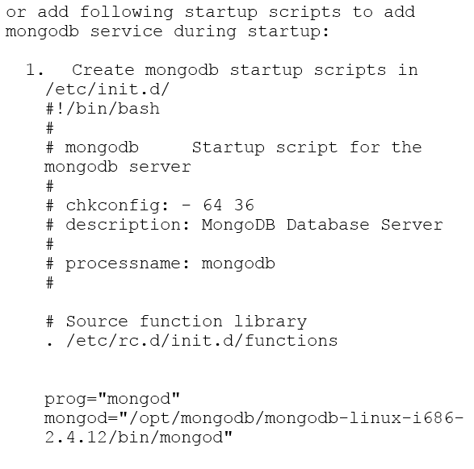
Mongodb in Linux

Slide 18
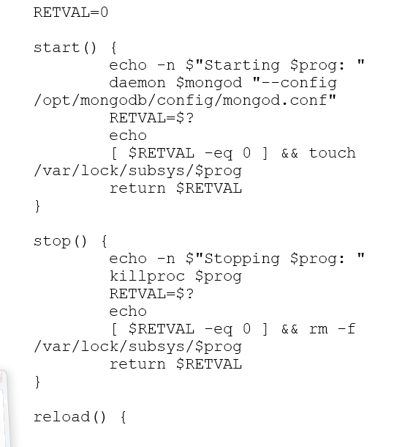
Mongodb in Linux

Slide 19
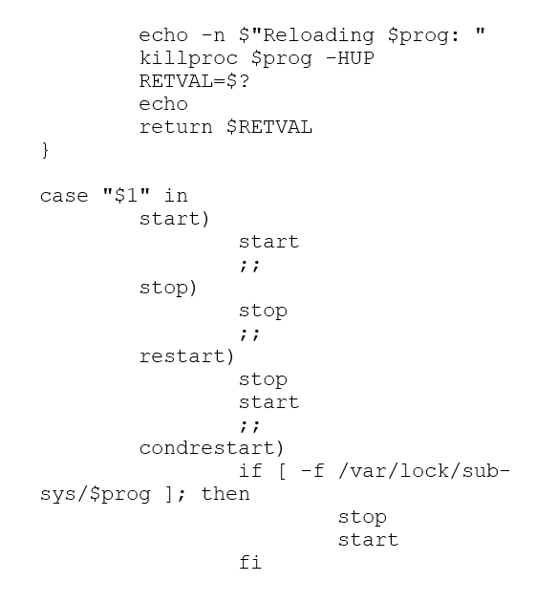
Mongodb in Linux

Slide 20
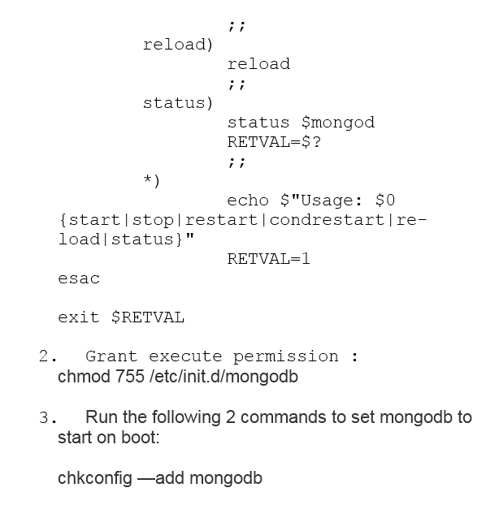

Mongodb in Linux

Slide 21


Verify the client
Execute some commands:-
Use training (use database ” training ”)
db. first.insert({“status": "installed successfully”} )
Db.first.find()
Database

Slide 22

what is configuration file?
How to start mongod.exe using configuration file?
What is log file and how to define logpath?

